Slide 1
Decision Tree: Feature Importance

Slide 2
Decision Tree: Feature Importance
Both Classification Tree and Regression Tree give us the ability to arrive at an idea of how important the predictors are.
This is done by computing “feature importance”.
Feature Importance, is computed as the total reduction of purity measure brought out by a feature.
Example:

Slide 3
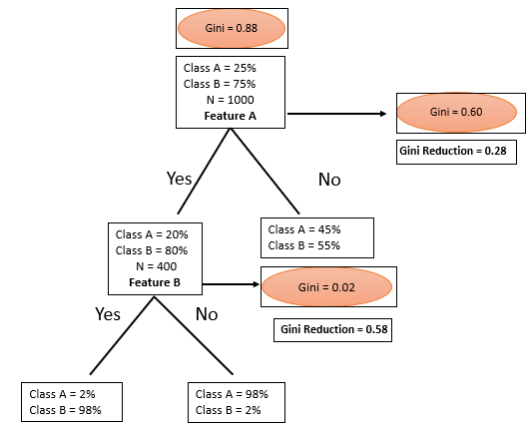


Decision Tree: Feature Importance
Which Feature, A or B, is more important?
Does the sequence of split matter?
Does the purity of split matter?
Both matter!!!!
Importance of A: Decrease in Gini*Proportion of data
Importance of A: $0.28∗\frac{1000}{1000}=0.28$
Importance of B: Decrease in Gini*Proportion of data
Importance of B: $0.58∗\frac{400}{1000}=0.23$

Slide 4
Decision Tree: Feature Importance
For a regression tree, one would look at the decrease in MSE or RSS by each feature and weighing this decrease appropriately.

